Slide 1
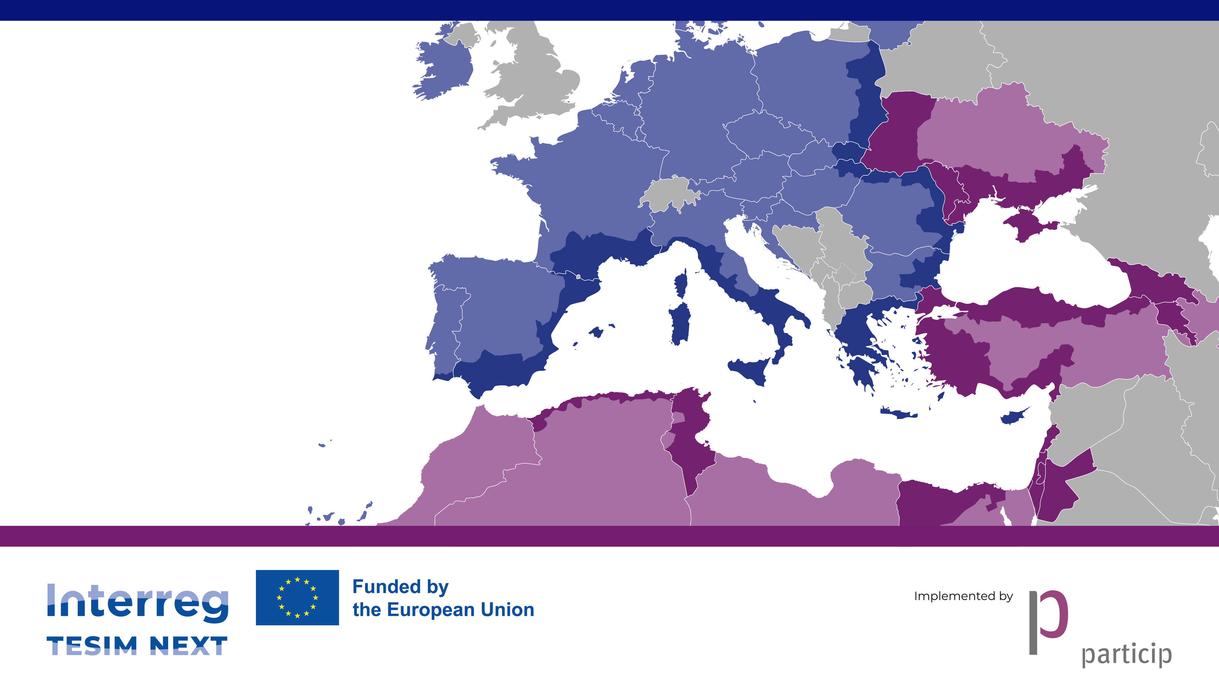
TESIM
Irregularities and conflict of interest. Recoveries
Online training for the beneficiaries of ROUA
26 March 2026

Slide 2

Today’s agenda
Introduction
Fraud, irregularities, corruption, conflict of interests
Management control system: does it concern beneficiaries?
Conflict of interests
Recoveries

Slide 3
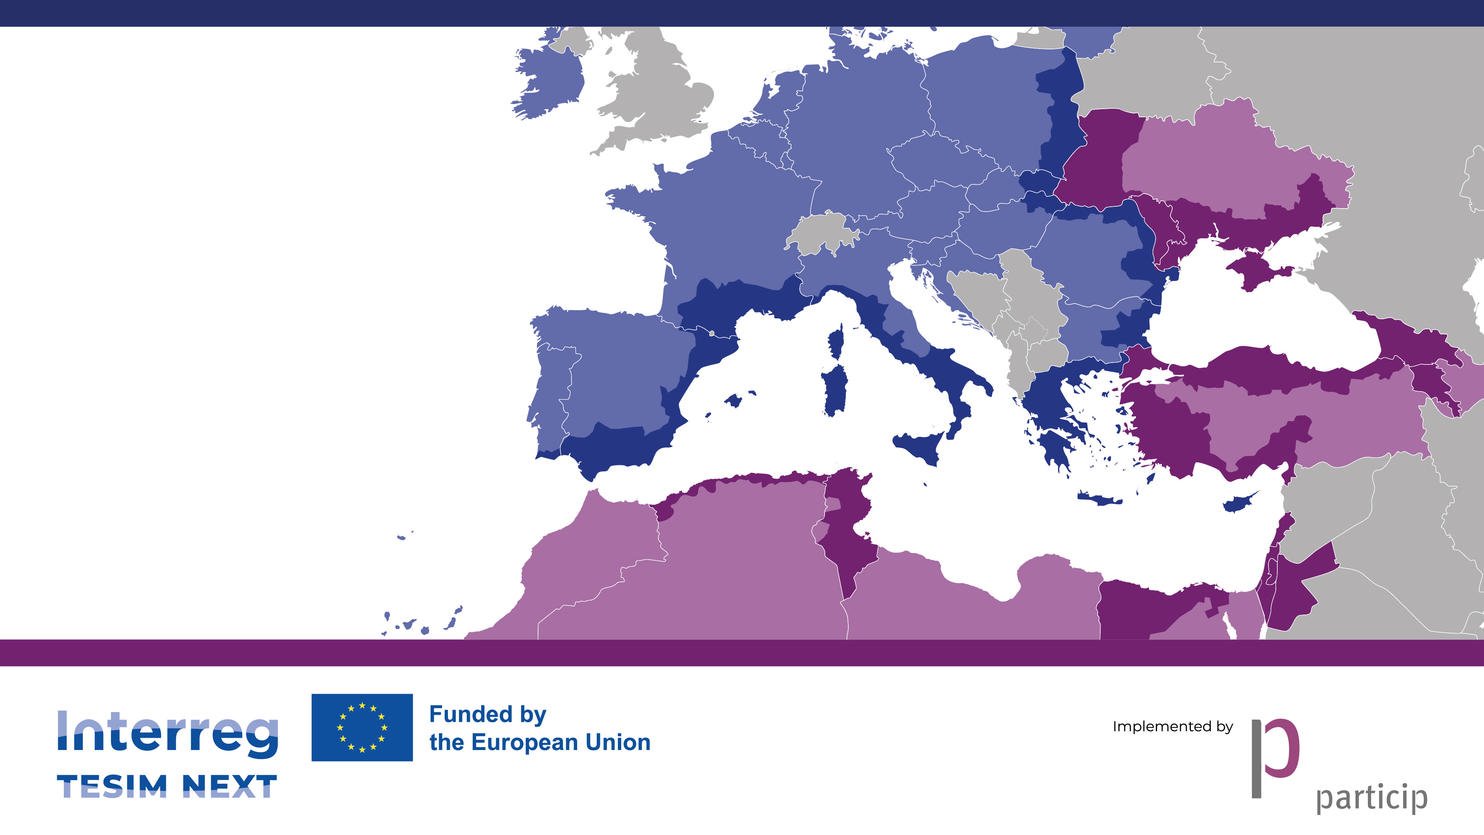
Introduction

Slide 4
Why we are here
Irregularities, conflict of interest, and recoveries are project-management issues, not only control issues
The highest exposure for beneficiaries usually arises in routine implementation decisions: staff costs, procurement, supporting documents, reporting, and internal decision-making
A case does not need to qualify as fraud to create financial consequences: ineligible expenditure, financial corrections, and recoveries may arise well before any final legal qualification
Early identification and proper handling protect both the beneficiary and the project partnership
Notes:
Monitoring involves much more than the JS – MC, MA also play big part in this process and they use the information collected in the monitoring for their informed decision-making.

Slide 5
The events and characters described during this session are NOT fictitious. Any resemblance of the examples with actual persons and facts is NOT purely coincidental.

Slide 6

Fraud, irregularities, corruption, conflict of interests

Slide 7
Basic definitions
Irregularity
An infringement of applicable rules affecting the EU budget
Fraud
An intentional irregularity
Corruption
A fraud with personal gain
Notes:
Monitoring involves much more than the JS – MC, MA also play big part in this process and they use the information collected in the monitoring for their informed decision-making.

Slide 8
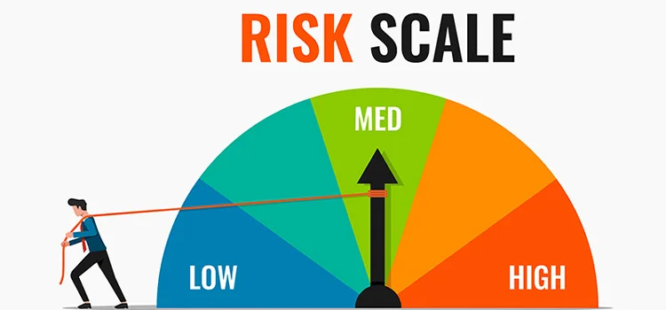
Our goal
Notes:
Monitoring involves much more than the JS – MC, MA also play big part in this process and they use the information collected in the monitoring for their informed decision-making.

Slide 9
Some examples of fraud and corruption
Corruption
Conflict of interest
Bribery
Misappropriation
Fraudulent procurement or disbursements
Misuse of funds or assets
Financial misstatement
Expenditure over-valuation
False supporting documents
Illegal gratuities
Economic or violent extorsion
Overstated performance indicators
False, incorrect or incomplete statements
Manipulation of tenders
Rigged specifications
Leaking bid data
Collusive bidding
Notes:
Monitoring involves much more than the JS – MC, MA also play big part in this process and they use the information collected in the monitoring for their informed decision-making.

Slide 10

A recent finding by a National Controller
Project 1
100% of time
Project 2
100% of time
Project 3
100% of time
Total time of the same person allocated in 3 projects: 300% of time

Slide 11
Measures to correct fraud
Article 5 of Regulation 2988/1995
“Intentional irregularities or those caused by negligence may lead to the following administrative penalties:
Payment of an administrative fine;
Payment of an amount greater than the amounts wrongly received or evaded, plus interest where appropriate (…);
Total or partial removal of an advantage granted (…)
Exclusion from, or withdrawal of, the advantage for a period subsequent to that of the irregularity;
Temporary withdrawal of the approval or recognition necessary for participation in a Community aid scheme; (…)”
Notes:
Monitoring involves much more than the JS – MC, MA also play big part in this process and they use the information collected in the monitoring for their informed decision-making.

Slide 12
How to prevent the problems

Slide 13

Institutional toolbox
Antifraud strategy
Antifraud statement
Training
Fraud risk assessment
Red flags
Awareness-raising
Whistleblowing
Data mining
Checks and controls
Notes:
Monitoring involves much more than the JS – MC, MA also play big part in this process and they use the information collected in the monitoring for their informed decision-making.

Slide 14
Three stages in detection of fraud and corruption
1
Alert
2
Suspicion
3
Establishment
Notes:
Monitoring involves much more than the JS – MC, MA also play big part in this process and they use the information collected in the monitoring for their informed decision-making.

Slide 15
Management control system: does it concern the beneficiaries

Slide 16
Responsibilities of participating countries
“Member States shall have management and control systems for their programmes […] and ensure their functioning in accordance with the principle of sound financial management and the key requirements listed in Annex XI.”
Article 69(1) of Common Provisions Regulation (CPR)
Regulation 1060/2021
REMEMBER!!
“MEMBER STATES” = “PARTICIPATING COUNTRIES” IN CPR
Notes:
Monitoring involves much more than the JS – MC, MA also play big part in this process and they use the information collected in the monitoring for their informed decision-making.

Slide 17
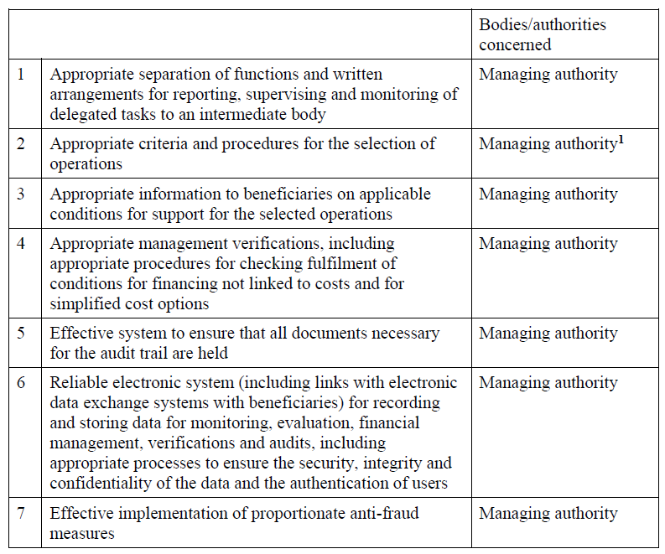
Annex XI of CPR. Key requirements
National bodies in Interreg
Notes:
Monitoring involves much more than the JS – MC, MA also play big part in this process and they use the information collected in the monitoring for their informed decision-making.

Slide 18

Key players at national level
National Authority
National Controller
Controllers
OLAF counterpart
Members of GoA
Other bodies at national level
And, of course...
Notes:
Monitoring involves much more than the JS – MC, MA also play big part in this process and they use the information collected in the monitoring for their informed decision-making.

Slide 19
Tasks to be performed
Information
The relevant information about fraud prevention measures (laws, programme documents, factsheets, information about trainings and training materials, etc) should be published on the website of the NA.
Capacity building
Capacity building in case of fraud prevention can be developed in two major ways:
by delivering training events for staff of all national institutions concerned with programme implementation;
via the organisation of the trainings for beneficiaries and controllers of approved projects, before projects start and during their implementation.
Detection and correction
The NA shall:
manage and assess the fraud alerts
provide support to the MA in matters relating to suspected or established fraud
inform the competent bodies at national level (OLAF counterpart, prosecutor, etc.)
Notes:
Monitoring involves much more than the JS – MC, MA also play big part in this process and they use the information collected in the monitoring for their informed decision-making.

Slide 20

What it takes to commit fraud
Opportunity:
Internal controls not in place, un-enforced, un-monitored or ineffective
Too much trust
Poor “tone at the top”
Not adequate segregation of duties
Feeling of impunity
Access to sensitive information
Rationalization:
“I don’t get paid what I worth”
“I intended to pay it back”
“Everyone is doing it and nobody is caught”
“If they don’t know I am doing it, they deserve to lose the money”
Motivation
(external pressure):
Debts
Life-style needs
Illegal activities (gamble, drugs, etc.)
Life pressure
Motivation
(internal pressure):
Pressure to perform
Too much work

Slide 21
What beneficiaries should do in practice
Prevent
establish clear internal responsibilities for authorising costs, procurement, and reporting
ensure full audit trail for staff costs, procurement, deliverables, and payments
declare and manage conflicts of interest before decisions are taken
verify eligibility, reality, and project relevance of expenditure before it is reported

Slide 22
What beneficiaries should do in practice
Detect
review high-risk areas regularly: staff time, procurement, supporting documents, and outputs
treat inconsistencies, missing evidence, unusual patterns, and pressure to “justify later” as red flags
do not rely only on signed declarations; check facts, links, and documentation
escalate concerns internally and to the programme chain without delay

Slide 23
Reporting irregularities

Slide 24
Article 69 of Common Provisions Regulation
Member States shall have management and control systems for their programmes […] and ensure their functioning.
Member States shall ensure the legality and regularity of expenditure included in the accounts submitted to the Commission and shall take all required actions to prevent, detect and correct and report on irregularities including fraud.
All countries are expected to appoint an irregularity officer with the function of confirming irregularities to the Managing Authority

Slide 25
Initial reporting in IMS
Irregularities …
that have been the subject of a first written assessment by a competent authority, either administrative or judicial.
that give rise to the initiation of administrative or judicial proceedings at national level in order to establish the presence of fraud or other criminal offences.
precede a bankruptcy.
for which the Commission submits a written request for information to the Member State.

Slide 26
Irregularities exempted from reporting in IMS
irregularities for an amount lower than EUR 10 000 in contribution from the Funds.
irregularities consisting solely of the failure to execute an operation owing to the non-fraudulent bankruptcy of the beneficiary.
cases brought to the attention of the Managing Authority (…) by the beneficiary voluntarily and before detection by either authority.
cases which are detected and corrected by the Managing Authority before inclusion in a payment application submitted to the Commission, except the suspected fraud.

Slide 27
Conflict of interest (CoI)

Slide 28

Basic definitions
Article 61 (Financial Regulation 2024/2509)
Conflict of interest
3. […] a conflict of interests exists where the impartial and objective exercise of the functions of a financial actor or other person […] is compromised for reasons involving family, emotional life, political or national affinity, economic interest or any other direct or indirect personal interest.
Notes:
Monitoring involves much more than the JS – MC, MA also play big part in this process and they use the information collected in the monitoring for their informed decision-making.

Slide 29
Why is it so important?
CoI threatens impartiality, credibility, and trust.
CoI is essential to protect the EU budget and ensure sound financial management.
Perceived or actual CoI can damage the integrity of decisions.
Non-compliance leads to irregularities, financial corrections, and reputational harm.

Slide 30
Legal definition
Article 61 Financial Regulation 2024:
Applies to: (i) Direct, indirect, and shared management; (ii) All financial actors and relevant staff.
Covers: (i) Family, emotional, political, economic, and other personal interests; (ii) Both actual and perceived.

Slide 31
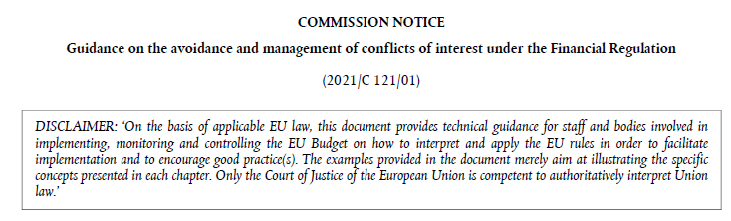
Resources
A Guidance was adopted by the EC in 2021
EUR-Lex - 52021XC0409(01) - EN - EUR-Lex

Slide 32
CoI may be…
Potential
Identified in early stages of the procedure and proactively communicated
Real
Identified by a third person once the procedure is closed
Apparent
One which a reasonable person would think that the professional's judgment is likely to be compromised.

Slide 33



Do not edit How to change the design
A project officer is asked to assess an application submitted by a university where his spouse works in the finance department. He informs the programme bodies before the assessment starts and is removed from the evaluation process. Type of CoI?
The Slido app must be installed on every computer you’re presenting from

Slide 34
Do not edit How to change the design
A procurement officer in an Interreg NEXT project is involved in selecting an external service provider. Which situations may qualify as a conflict of interest? Select all that apply.
The Slido app must be installed on every computer you’re presenting from

Slide 35

Declaration of absence of CoI
Is it enough to check if there are signed declarations of absence of conflict of interest?
What else can be done? How can I know that the best friend of the wife/husband of a member of the evaluation committee had confidential information leaked?

Slide 36
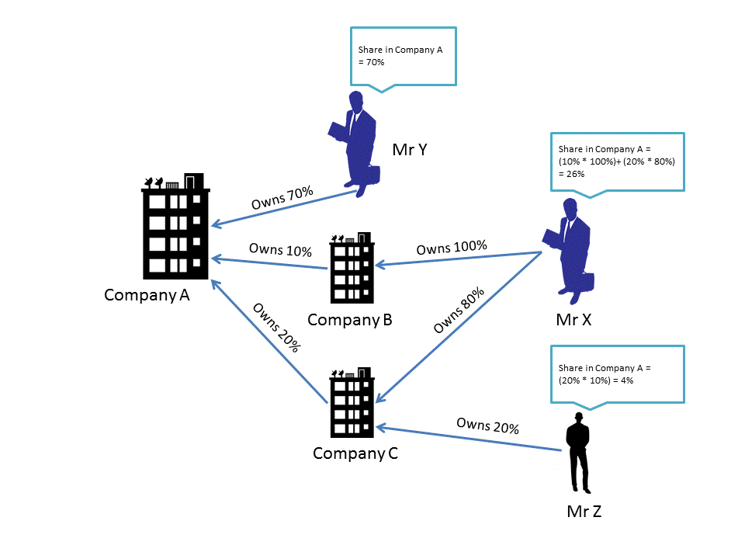

What can we do to identify CoI
Datamining: a powerful tool for the detection
How can we identify the “beneficial owners”?

Slide 37
What if this work leads to recoveries?

Slide 38
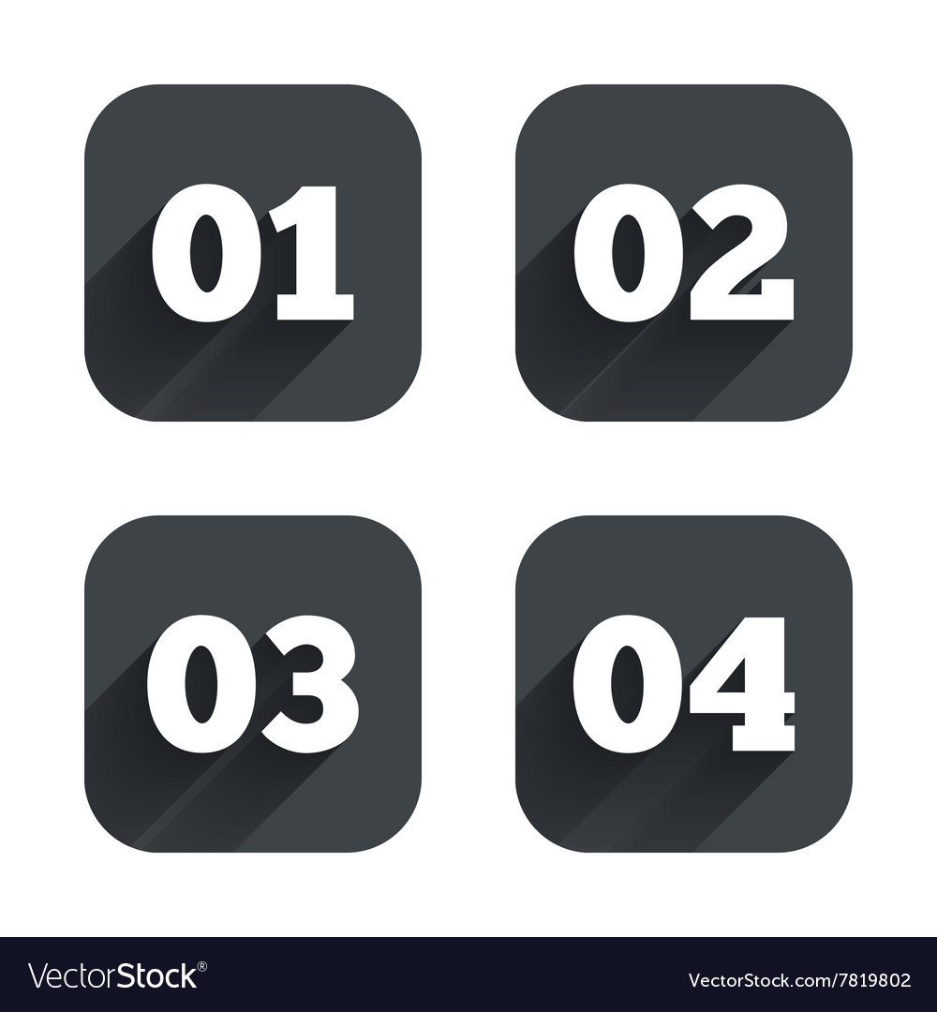
The recovery chain
4 steps for certainty in recoveries
Notes:
Monitoring involves much more than the JS – MC, MA also play big part in this process and they use the information collected in the monitoring for their informed decision-making.

Slide 39
The recovery chain
Article 52 of Interreg Regulation (1059/2021)
‘1. The managing authority shall ensure that any amount paid as a result of an irregularity is recovered from the lead […] partner. Partners shall repay to the lead partner any amounts unduly paid.’
MA issues a recovery order for the concerned partner and send it to the Lead Partner (LP). The concerned partner pays to the LP, who repays the amount to the MA.
Possible waivers of amounts up to EUR 250 per project per year
Notes:
Monitoring involves much more than the JS – MC, MA also play big part in this process and they use the information collected in the monitoring for their informed decision-making.

Slide 40
The recovery chain
Article 52 of Interreg Regulation (1059/2021)
‘3. Where the lead partner does not succeed in securing repayment from other partners or where the managing authority does not succeed in securing repayment from the lead […] partner, the […] country on whose territory the partner concerned is located or […] is registered, shall reimburse the managing authority any amounts unduly paid to that partner.’
MA issues a recovery order for the country, who repays the amount to the MA.
Notes:
Monitoring involves much more than the JS – MC, MA also play big part in this process and they use the information collected in the monitoring for their informed decision-making.

Slide 41
The recovery chain
Article 52 of Interreg Regulation (1059/2021)
‘4. Once the […] country has reimbursed the managing authority any amounts unduly paid to a partner, it may continue or start a recovery procedure against that partner pursuant to its national law.’
NA or the competent national body start the procedure for recovery in accordance with the national law and procedures.
Notes:
Monitoring involves much more than the JS – MC, MA also play big part in this process and they use the information collected in the monitoring for their informed decision-making.

Slide 42
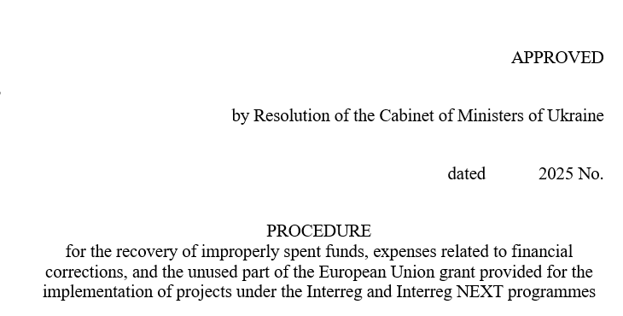
Procedures need to be embedded in national legislation
Example from Ukraine, who is about to approve a decree on recoveries in Interreg

Slide 43
The recovery chain
Article 52 of Interreg Regulation (1059/2021)
‘5. Where a […] country has not reimbursed the managing authority any amounts unduly paid to a partner […], those amounts shall be subject to a recovery order issued by the Commission which shall be executed, where possible, by offsetting to the […] country.
With regard to amounts not reimbursed to the managing authority by a […] partner country, the offsetting shall concern subsequent payments to programmes under the respective external financing instruments of the Union.’
The EC identifies future payments from other DGs to the partner country and offsets the amount due.
Notes:
Monitoring involves much more than the JS – MC, MA also play big part in this process and they use the information collected in the monitoring for their informed decision-making.

Slide 44
Recap
Irregularities, fraud and corruption is a part of our lives, everyone must be careful
Make sure that your staff is well aware about preventive measures against irregularities, fraud and corruption
Make sure that you stay up to date
Fraud prevention is not a formality, it is a systematic work during the entire project

Slide 45
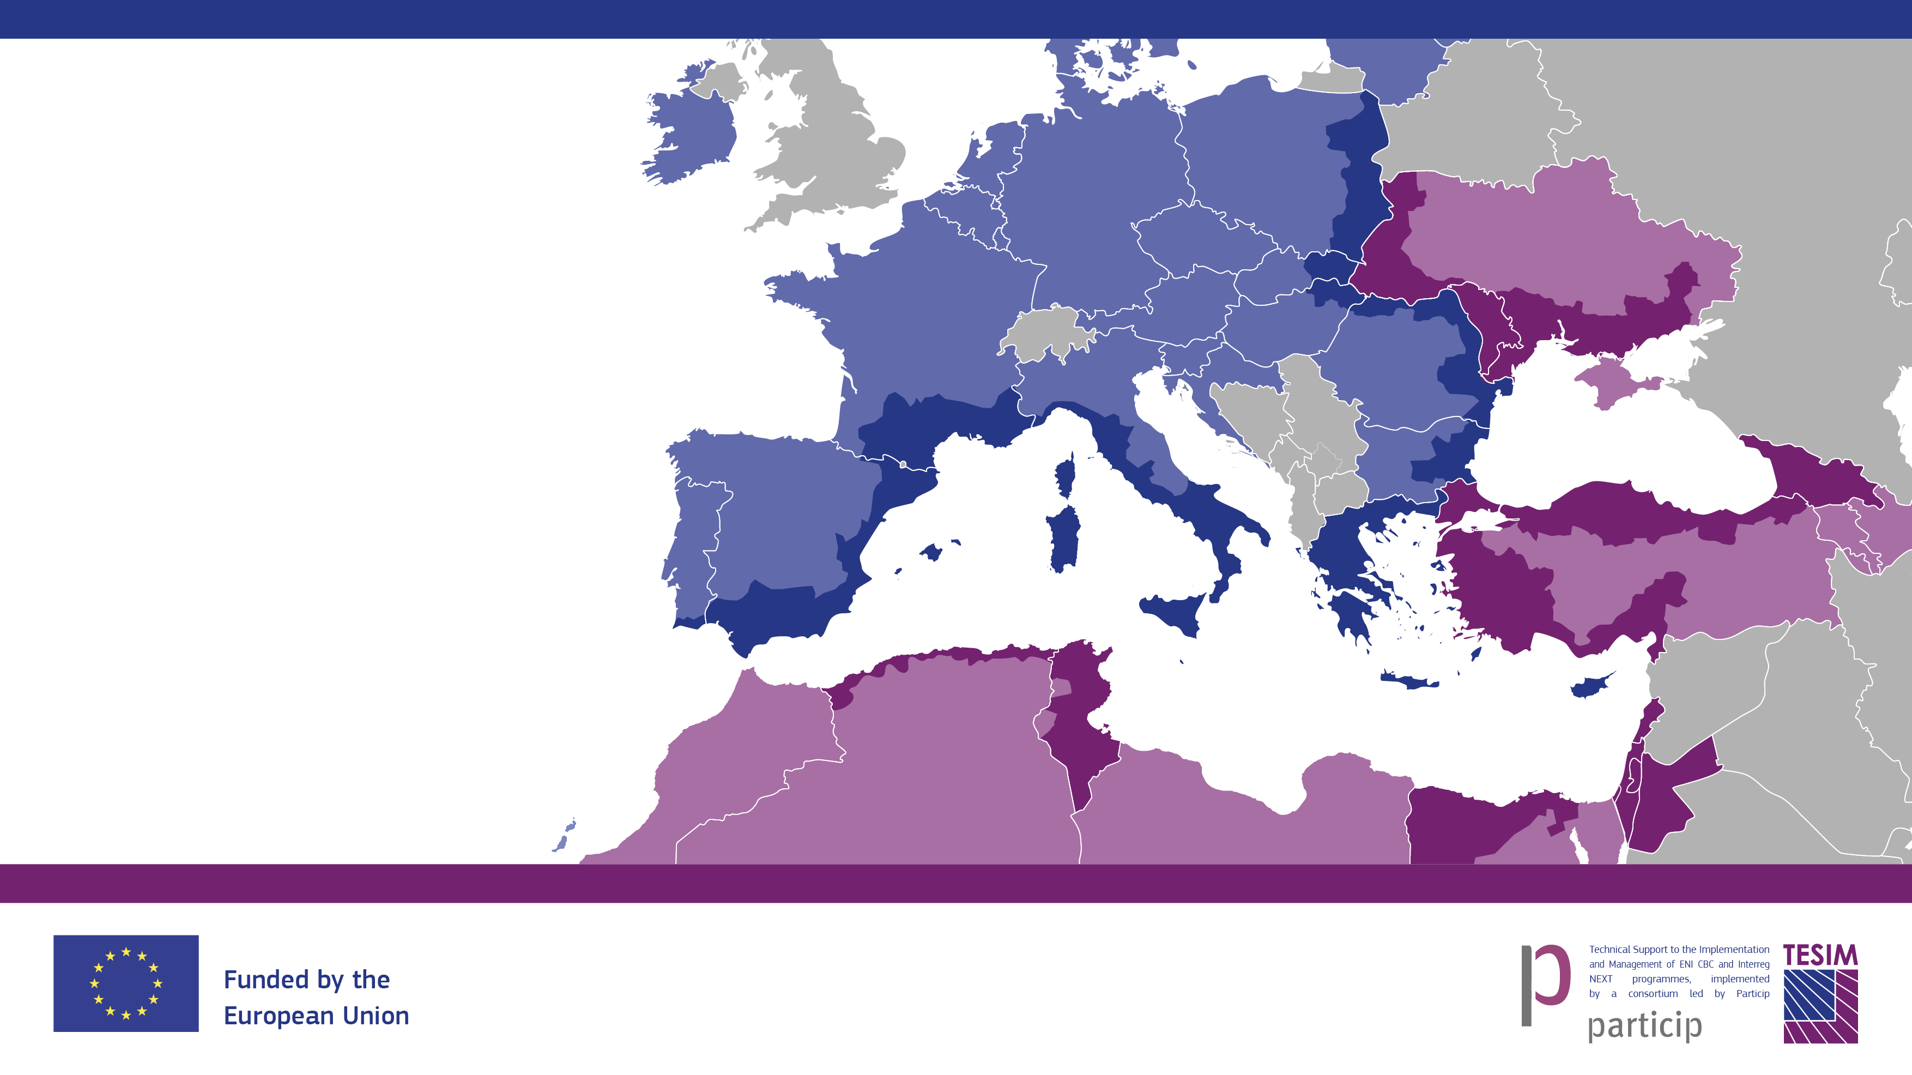







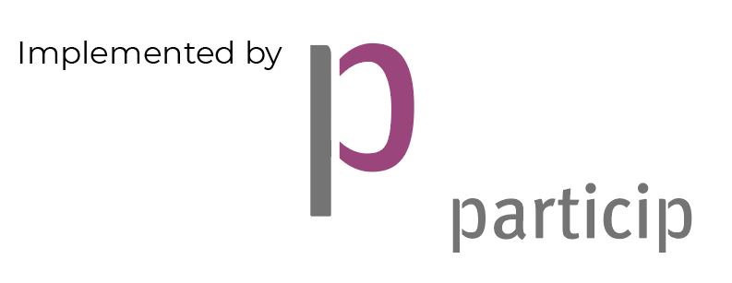
Full responsibility requires
adequate tools!
Remember to:
Follow us on
Visit our website, check our library and take a tour in our exhibition of projects
Subscribe to our bulletin and to our “News from the Regions”
Because neighbours matter!

